Slide 1


Team Leadership
Workshop
Uladzimir Litvinau
June 2023
Notes:
EngX Program

Slide 2
Table of Contents
01
Speaker
07
Use-Cases
02
Rules
08
Homework
03
How to learn?
09
Q&A
04
TL: Responsibilities
05
TL: Definitions
06
Team development model

Slide 3
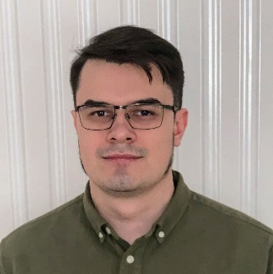
Speaker: Uladzimir Litvinau
Software Engineering Team Leader
01
Experience:
Head of Java Department in xxx company (150+)
BE Guild Lead on WALG-CORE project in EPAM (600+)
Primary Skills:
Java
Leading

Slide 4
Work hard now
Save thousands of hours and nerves in future…
Every team lead should start from:
Session Rules
No multitasking – 1,5 hour of concentration
This knowledges will be useful and for leads and for team members
10 years of experience key lessons learned
Be active (teamlead should have and be able to express his opinion, to start a search of solution)
Back to school
Formulate your statements correctly - do not forget about the characteristic of measure (sometimes, always, never, from my experience and etc)

Slide 5




Mentimeter Link
Notes:
We’ll have a lot of staff to discuss

Slide 6


What is the difference in learning style of child and an adult?…
On current session, As a Lead, As A Team member
How to learn and how to teach?
Let’s try to find out using mentimeter!
VS
Notes:
Children
Adults – 90% is self education
1. Rely on others to decide what’s to be learned.
1. Decide for themselves what they want to learn.
Not always or necessarily. It depends on what children: age, gender, socio-economic and cultural background, teaching and learning experience at home, in school, etc.
Not always. It depends on what adults: age, gender, socio-economic and cultural background, educational level, etc.
2. Accept information at face value.
2. Question information, need to validate.
Not necessarily. Same as 1.
Not necessarily. Same as 1.
3. Expect learned information to be useful in the future.
Expect information to be useful now.
Not necessarily.
Many children (i.e. older children, the poor) would expect to learn something that they see useful and relevant now.
Are clean slates with little or no experience.
Are full slates with lots of experience.
Children are never clean slates. They have knowledge and experience no matter their age.
No one is ever a full slate. Adult learners may have no experience (knowledge and skills) in some specific areas.
Have limited ability to be a resources to classmates.
Significant ability to serve as resource to others.
Children have great abilities to help others, not only peers but also young people and adults.
Are content-centered.
Are process or problem-centered.
If given the chance, they also enjoy problem-solving and are interested in understanding the methodology and the process.
Many adults are also keen on information and content. It also depends on the content taught.
Are passively involved in learning.
Are actively involved in learning.
Because the school system often sets such rules. Children prefer to engage actively in learning.
Not necessarily, not always. Very often adults are also passive learners, conditioned by conventional education and training practices in and out of the school system.
Learning requires active involvement.
Learn best in an authoritative environment.
Learn best in a collaborative environment.
Not generalizable.
Not generalizable.
If given the chance, children enjoy learning in flexible, non-fear environments.
Many adult learners prefer more structured, authoritative environments.
Are motivated by external rewards: grades, advancement, avoidance of punishment.
Are motivated internally: self-esteem, curiosity, love of learning, self-improvement.
Children may be also internally motivated - the best way to learn.
Adults are often also externally motivated. (Teacher training is often a typical example of institutionalized externally motivated learning).

Slide 7
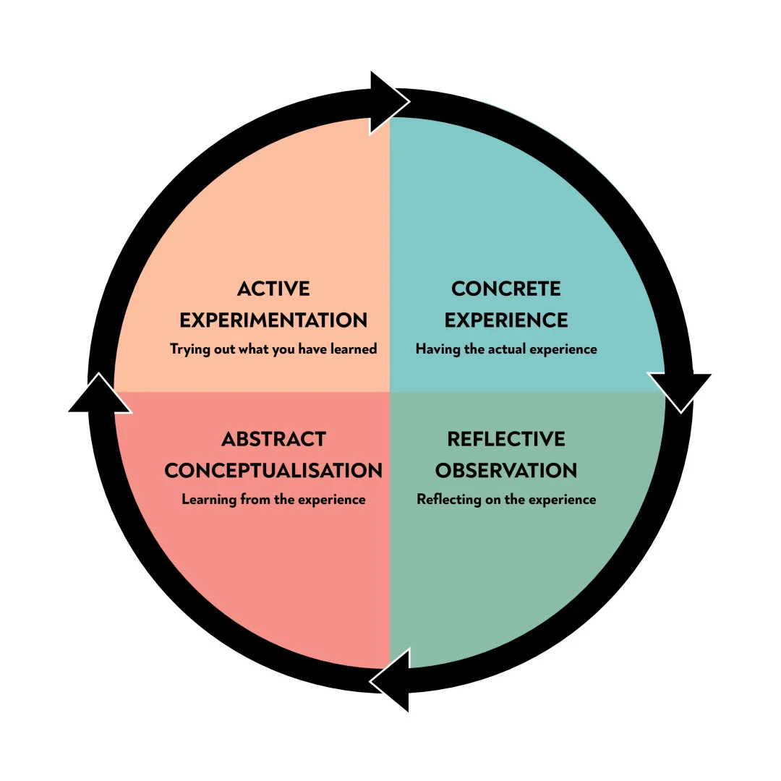
Kolb's Experiential Learning Theory
How to learn and how to teach
Kolb’s experiential learning style theory is typically represented by a four-stage learning cycle in which the learner “touches all the bases”
Concrete Experience – the learner encounters a concrete experience. This might be a new experience or situation, or a reinterpretation of existing experience in the light of new concepts.
Reflective Observation of the New Experience – the learner reflects on the new experience in the light of their existing knowledge. Of particular importance are any inconsistencies between experience and understanding.
Abstract Conceptualization – reflection gives rise to a new idea, or a modification of an existing abstract concept (the person has learned from their experience).
Active Experimentation – the newly created or modified concepts give rise to experimentation. The learner applies their idea(s) to the world around them to see what happens.
Notes:
It’s foundation for learning styles
All of you already have some experience and open cases, that’s why I can do a short overview of some theory that will be helpful for our use cases, but the main learning part will be when you’ll work on your homework after working on use cases today, and learning theory a more deep by your own

Slide 8
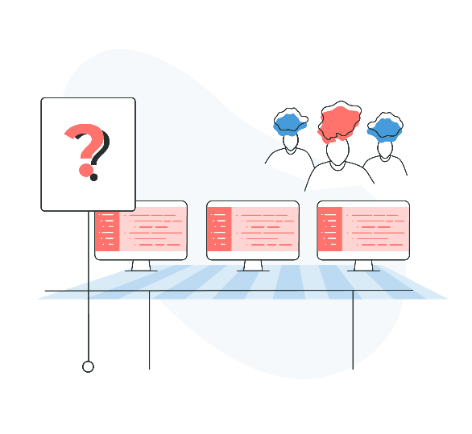
What are the key skills of Team Lead?
Tricky question
Before the discussion

Slide 9
A team is a small number of people with complementary skills who are committed to a common purpose, set of performance goals, and approach for which they hold themselves mutually accountable.
Key definition
Definition of Team
Notes:
The Discipline of Teams (hbr.org)

Slide 10
What are the key skills of Team Lead?
Tricky question
Let’s try to find out now
Let’s try to find out using mentimeter!
Notes:
The 8 Key Leadership Skills You need to know in 2023 (imd.org)

Slide 11




Key Skills and Roles
Team Lead
Common skills | Personal skills | Roles and responsibilities | Key activities
Read (how to read) Listen Analyze and synthesize (formal logic) Discuss (art of discussion) Learn Teach Solve Lead | Relationship building Agility and adaptability Innovation and creativity Employee motivation Decision-making Conflict management Negotiation Critical Thinking | Administrator Integrator People manager Product owner Technical lead | Team development Estimation Leading agile practices Feedback activities Knowledge sharing Facilitation Teaching
Notes:
The 8 Key Leadership Skills You need to know in 2023 (imd.org)

Slide 12
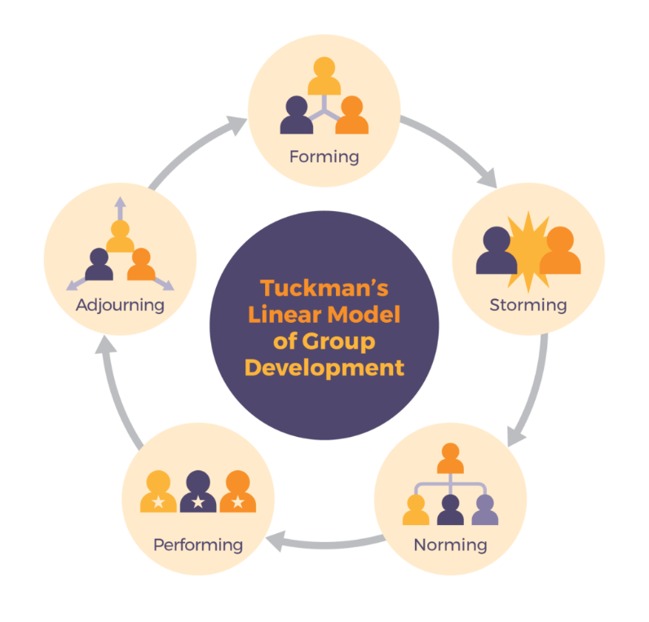
Team development model by Tackman
Your Main Activity
How to build a Team?
Notes:
Message from FreshBooks
Tuckman's Stages of Group Development - WCU of PA (wcupa.edu)
Maybe add more slides for each step for takeaways
Team development stageLeadership strategiesKeys to successForming (setting the stage)^{[12]}Coordinating behaviors– Purposefully picking the team– Facilitating team to identify goals
– Ensuring the team development of a shared mental model
Storming (resolving conflict and tension)^{[12]}Coaching behaviors– Act as a resource person to the team– Develop mutual trust
– Calm the work environment
Norming and performing (successfully implementing and sustaining projects)^{[12]}Empowering behaviors– Get feedback from staff– Allow for the transfer of leadership
– Set aside time for planning and engaging the team
Outperforming and adjourning (expanding initiative and integrating new members)^{[12]}Supporting behaviors– Allow for flexibility in team roles– Assist in the timing and selection of new member
– Create future leadership opportunities

Slide 13
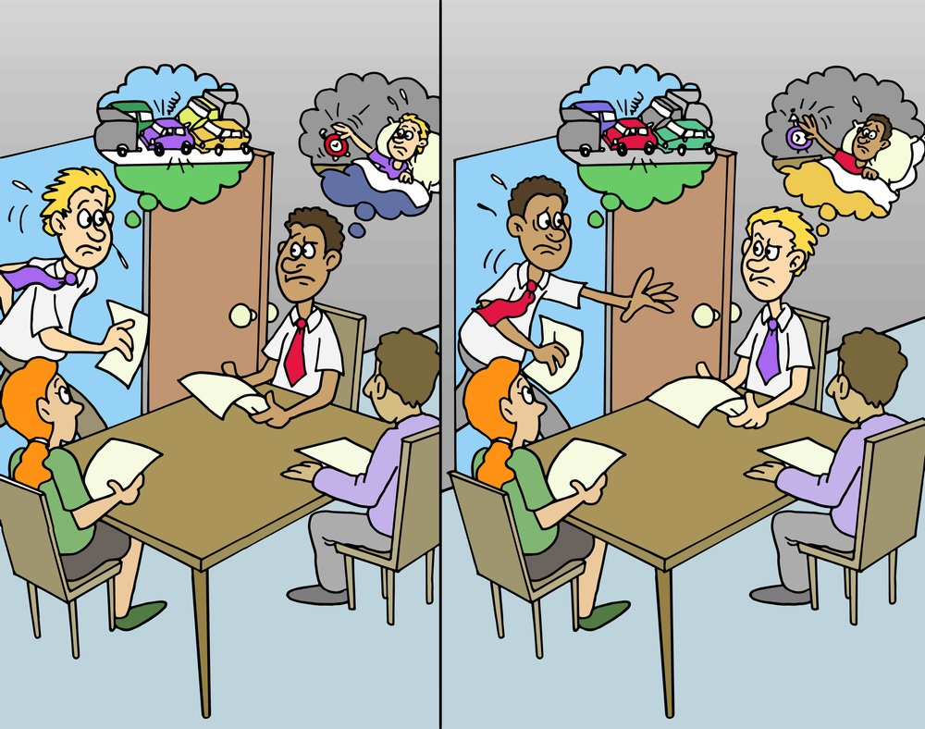
THE FUNDAMENTAL ATTRIBUTION ERROR
Point of view problem
The fundamental attribution error refers to an individual's tendency to attribute another's actions to their character or personality, while attributing their behavior to external situational factors outside of their control.
In other words, you tend to cut yourself a break while holding others 100 percent accountable for their actions.
Notes:
Fundamental Attribution Error: What It Is & How to Avoid It (hbs.edu)

Slide 14
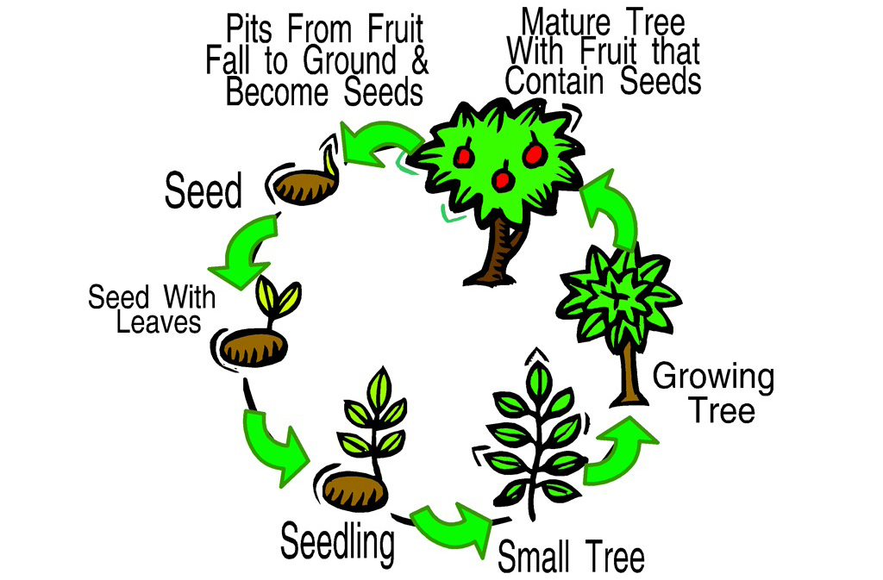
Dialectical method (logic)
A bit of Philosophy
“Dialectics” is a term used to describe a method of philosophical argument that involves some sort of contradictory process between opposing sides.
The main idea of dialectics is to look at any object or phenomenon in development, and see the mutual influence both on other objects and phenomena, and from them.
Try to look at every situation in 3 types of perspective:
from many sides and point of views in the current moment
in progress - how did we come to this situation and what results will we face in future
in collision - how does this situation affects other workers and processes
Notes:
There are some additional interesting rules, but main takeaway is to analyze situation in many dimensions including time – how we get here, and what will be the consequences (results) in the future.
Even extremely good solution today, in long perspective could bring a terrible consequences, and it works and in reverse as well – not very good solution today may be the best one in long term.

Slide 15







So, you've just become a team lead of new team that will work on new project…
Team Leadership workshop: USE-cases
Dean - SM
Team:
Adam - key senior developer with a huge experience, more interested in technical staff
Bob - strong middle+ developer with specific experience, which is required for this project - also he very likes his previous team and its lead, and he doesn't believe that this team can be half as good as previous
Eva - junior superstar developer, likes to learn and is interested in everything new
Diana - tester, wants to grow in test automation
Mary - PO + BA from client's side, owns most of the communications with the customer
Dean - scrum master, he is good at setting up of standard ceremonies, but don't expect more from him
Pavel - DevOps, trying to make fully automated CI / CD on the project
Adam – SD
Mary – PO/BA
Bob – MD
Eva - JD
Diana - QA
Pavel - DevOps
You
Notes:
Takeaways are bold, good solution today may bring a very bad consequences tomorrow

Slide 16
You've just met your new team.
What will be your first actions?
Team Leadership workshop: USE-cases
Case 1: New beginning
Dean - SM
Adam – SD
Mary – PO/BA
Bob – MD
Eva - JD
Diana - QA
Hello team group!
Pavel - DevOps
You
Notes:
Basic rules and ceremonies
One on ones (gathering the information from previous slide)
Environment setting up (quality gates and pipelines)
Using of expertise
Creating a PDPs and Successors plans
Pair programming and KS sessions
RACI matrix
Team building is fine

Slide 17
In your work you need two frameworks, the first is required from client's side. The second you and your team should choose.
How will you do it?
Team Leadership workshop: USE-cases
Case 2: Choice
Dean - SM
Adam – SD
Mary – PO/BA
Bob – MD
Eva - JD
Diana - QA
?
Pavel - DevOps
You
Notes:
Experience
Technologies support and popularity
Team desires
Your authority

Slide 18
Client asks you to estimate first epic with the list of stories.
How will you do it, what instruments and practices will you use for it?
Team Leadership workshop: USE-cases
Case 3.1: Estimation
Dean - SM
Adam – SD
Mary – PO/BA
Bob – MD
Eva - JD
Diana - QA
?
Pavel - DevOps
You
Notes:
Man hours or story points – what is the difference
Measure of complexity, which is individual for the team, and depends from SP definition – for example controller + simple service + db access class is good for the beginning, but you should change it when you’ll have an examples from current project

Slide 19
After estimation session Eva said that she doesn't understand how estimation works, for her is obvious, that she'll do same task as Adam for x100 times longer.
What will you do with it?
Team Leadership workshop: USE-cases
Case 3.2: Estimation
Dean - SM
Adam – SD
Mary – PO/BA
Bob – MD
Eva - JD
Diana - QA
?
Pavel - DevOps
You
Notes:
From the very beginning you and your future team members are spiking on a different languages, same words have a different meaning for you, that’s why you should define and speak over and over again basic, obvious staff – you should teach your team to understand you and your style of explanation, and to give a possibility for team members try to explain such stuff, you’ll listen, learn more about your team, and will help to set up the communication
Plus – as soon you’ll find contradictions, as easy and fast you’ll go through storming phase

Slide 20
PO thinks that your estimation is too large, she thought that it will take less time or story points.
What will you do?
Team Leadership workshop: USE-cases
Case 3.3: Estimation
Dean - SM
Adam – SD
Mary – PO/BA
Bob – MD
Eva - JD
Diana - QA
?
Pavel - DevOps
You
Notes:
RACI and zones of responsibility should be defined from the start

Slide 21
You and the rest of the team see that something bad is happening between Adam and Bob, in the first weeks they tried to just ignore their differences, but now you all see that every day the estimation, code review or even discussion about any issue leads to conflicts.
What will you do?
Team Leadership workshop: USE-cases
Case 4: First conflicts
Dean - SM
Adam – SD
Mary – PO/BA
Bob – MD
Eva - JD
Diana - QA
?
Pavel - DevOps
You
Notes:
RACI and zones of responsibility should be defined from the start

Slide 22
Diana complains that after implementing of every feature something is breaking in features that was implemented before, she asks you to do something with it.
What will be your actions?
Team Leadership workshop: USE-cases
Case 5.1: Tests and testers
Dean - SM
Adam – SD
Mary – PO/BA
Bob – MD
Eva - JD
Diana - QA
?
Pavel - DevOps
You
Notes:
RACI and zones of responsibility should be defined from the start

Slide 23
Whatever decision you’ve made, in few weeks after, you can see that Bob is ignoring your decision and Eva is taking he's behavior as an example.
What will you do?
Team Leadership workshop: USE-cases
Case 5.2: Tests and testers
Dean - SM
Adam – SD
Mary – PO/BA
Bob – MD
Eva - JD
Diana - QA
?
Pavel - DevOps
You
Notes:
RACI and zones of responsibility should be defined from the start

Slide 24
Bob starts to be a bottleneck - his capacity isn't enough to solve all required issues.
How can you solve it?
Team Leadership workshop: USE-cases
Case 6.1: Bottleneck and bus factor
Dean - SM
Adam – SD
Mary – PO/BA
Bob – MD
Eva - JD
Diana - QA
?
Pavel - DevOps
You
Notes:
RACI and zones of responsibility should be defined from the start

Slide 25
After 6 moth from start of the project Bob broke his arm, and he will not be able to work for 3 weeks.
Are you ready for this situation? What should you do if you are ready, and what if you are not?
Team Leadership workshop: USE-cases
Case 6.2: Bottleneck and bus factor
Dean - SM
Adam – SD
Mary – PO/BA
Bob – MD
Eva - JD
Diana - QA
?
Pavel - DevOps
You
Notes:
RACI and zones of responsibility should be defined from the start

Slide 26
Client asks your team to add ultra high priority task in the middle of current sprint. Adam doesn't think that this is a good idea, Mary thinks that we just must do it anyway.
What will you do and how will you convince your position or decision?
Team Leadership workshop: USE-cases
Case 7: Breaking of sprint
Dean - SM
Adam – SD
Mary – PO/BA
Bob – MD
Eva - JD
Diana - QA
?
Pavel - DevOps
You
Notes:
RACI and zones of responsibility should be defined from the start

Slide 27
User story contains several tasks, one of which has tiny functionality but at the same time requires a large effort.
How will you communicate it with PO / customer?
Team Leadership workshop: USE-cases
Case 8: Effort and impact
Dean - SM
Adam – SD
Mary – PO/BA
Bob – MD
Eva - JD
Diana - QA
?
Pavel - DevOps
You
Notes:
Sometimes only you is the one who could provide information about effort measure

Slide 28
Business Analyst creates contradiction requirements unclear for developers.
What will be your actions?
Team Leadership workshop: USE-cases
Case 9: Unclear requirements
Dean - SM
Adam – SD
Mary – PO/BA
Bob – MD
Eva - JD
Diana - QA
?
Pavel - DevOps
You
Notes:
Idea is to provide a situation when you need to change a style of working of team member not from your technical pool

Slide 29
Developer from your team wants to become a teamlead (who is it depending on your previous decisions).
What will you do?
Team Leadership workshop: USE-cases
Case 10: Team Lead
Dean - SM
Adam – SD
Mary – PO/BA
Bob – MD
Eva - JD
Diana - QA
?
Pavel - DevOps
You
Notes:
Idea is to provide a situation when you need to change a style of working of team member not from your technical pool

Slide 30
10 minutes before the customer demo, you notice that the app/feature you want to demo isn't working.
What will you do?
Team Leadership workshop: USE-cases
Case 11: Demo
Dean - SM
Adam – SD
Mary – PO/BA
Bob – MD
Eva - JD
Diana - QA
?
Pavel - DevOps
You
Notes:
Idea is to provide a situation when you need to change a style of working of team member not from your technical pool

Slide 31
You did a very good job, customer is happy, team very likes you and each other, team spirit is very-very high. But you know, that soon project will be over, the job is done.
What should you think about it and what should you do?
Team Leadership workshop: USE-cases
Case 12: The End
Dean - SM
Adam – SD
Mary – PO/BA
Bob – MD
Eva - JD
Diana - QA
?
Pavel - DevOps
You
Notes:
Idea is to provide a situation when you need to change a style of working of team member not from your technical pool

Slide 32

Homework
Write your own solution for each case, try to think about consequences of your own decisions

Slide 33
Q&A
Feel free to write them in the chat

Slide 34
Feedback and takeaways
Help the program to become better

Slide 35
Thank you!
Please contact us
uladzimir_litvinau@epam.com
wl.litvinov@gmail.com

